Slide 1
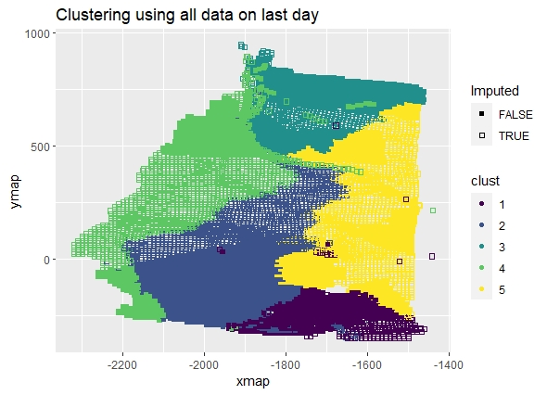
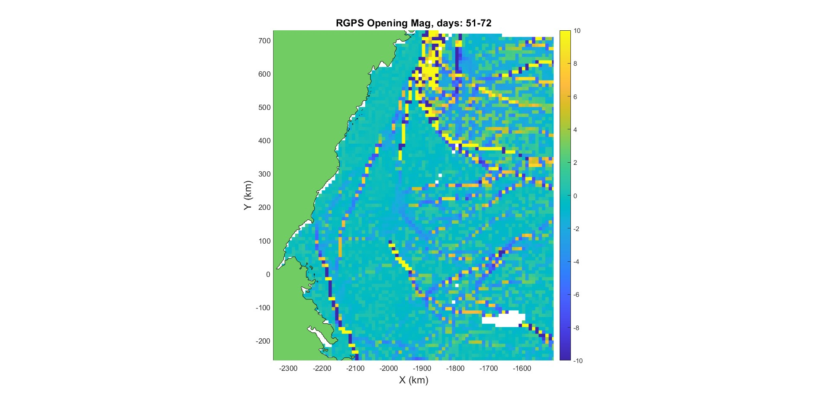
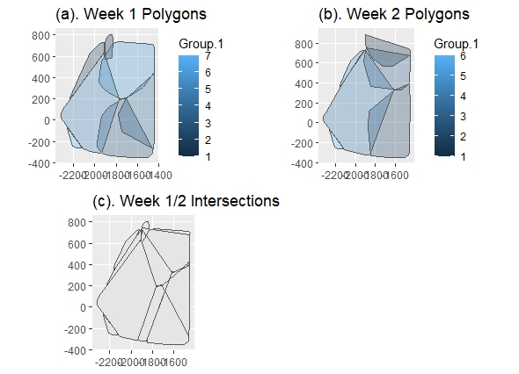
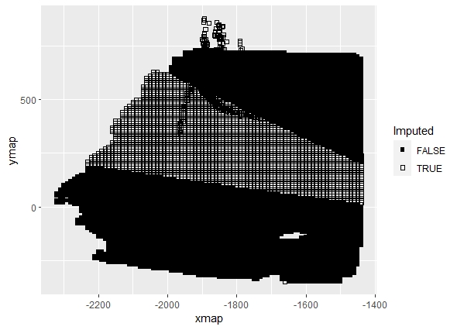
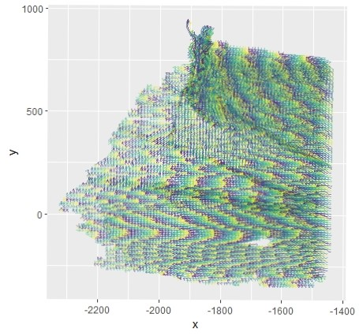
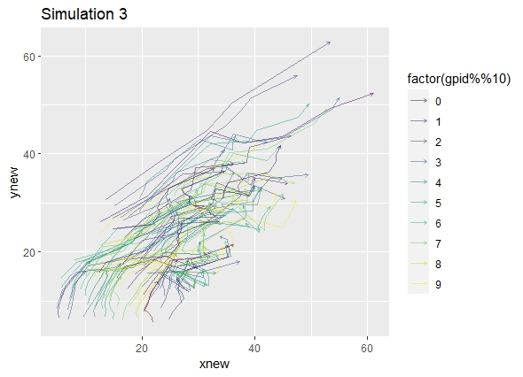
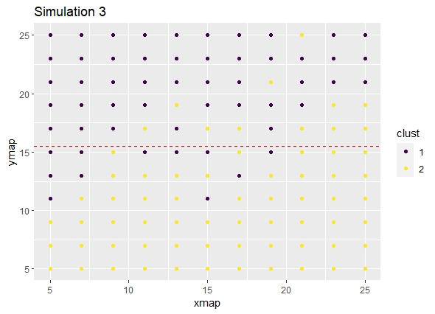
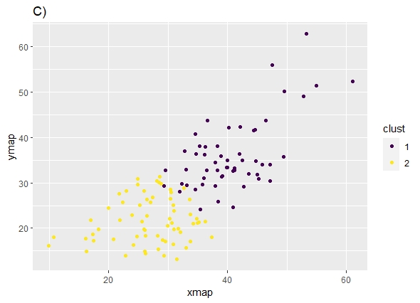

A Spatio-Temporal Model for Arctic Sea Ice
Alison Kleffner, Susan VanderPlas, Yawen Guan
Department of Statistics, University of Nebraska - Lincoln
Introduction
Sea ice is frozen water in the Arctic Ocean that generally occurs as an ice pack which can drift over the oceans surface Cracks, or leads, may form in the ice pack due to dynamic processes Allows for heat from the ocean to be transferred to the atmosphere, accounting for part of the heat flux between the ocean and the atmosphere Other ice lead detection methods generally, involve the use of thermal images or deformation calculations found through satellite images Can be low in resolution and are affected by atmospheric conditions
Intersection Interpolation
Method involves defining the spatio-temporal neighbors for each missing point, using our previously made clusters The overlap of a week’s clusters with the week before and after would create groups, where each member is a spatio-temporal neighbor of the others. This is because members are in a similar geographic region over time. Created univariate models for x and y using the GpGp package in R, which uses the Vecchia’s approximation, using the exponential space-time covariance function The output for this model is the maximum Vecchia likelihood estimates for the mean and covariance parameters. These estimates then can be used to predict the unobserved locations at that time. A grid encompassing the data was created for each time to give an initial starting point for the estimation of the missing points in the model, using the centroid of the grid cell. From this, predictions for x or y are done using the fitted model
Ice Data Results
Clustering: Interpolation: Assign 10% in desired time/intersection combination to be missing Used data in intersection from day before and day after to develop model
Data
Used motion data from the RADARSTAT Geophysical Processing System (RGPS) The movement of sea ice is tracked in sequential radar images Due to this data collection, data may be missing
RMSE for Interpolation Methods
 | Intersection Method |  | Linear Interpolation
Week | X | Y | X | Y
1 | 3.141 | 3.228 | 1.52 | 4.098
2 | 3.135 | 3.063 | 1.984 | 1.399
3 | 3.166 | 3.081 | 0.987 | 1.189
RMSE for Week 1 by Cluster
 | Intersection Method |  | Linear Interpolation
Cluster | X | Y | X | Y
1 | 3.137 | 4.276 | 3.199 | 13.042
2 | 4.364 | 4.622 | 0.187 | 0.359
3 | 2.647 | 3.139 | 1.314 | 3.066
4 | 3.006 | 2.873 | 1.396 | 2.442
5 | 3.946 | 3.561 | 0.74 | 3.036
6 | 3.109 | 3.08 | 1.876 | 5.459
Method Motivation
It can be seen in this figure that there seems to be groups movement patterns within the ice pack. Tracked identifiers in the ice sheet can be grouped together when have similar movement.
Simulation Study
Conclusion
Bounding Box method is limited by pre-defined number of clusters, but seems to discover large ice leads. Should be used in conjunction with other ice lead detection methods Intersection Interpolation Method shows promise over linear interpolation when data is not linear. Some issues in model creation – like if not enough known data in that intersection for a given time, large temporal range, etc.
Bounding Box Clustering
Created a bounding box around each trajectory, to represent the movement of the trajectory over time. Features used: Length of x/y traveled (between max and min location) Difference in x/y from latest to earliest observation Angle of movement Average x/y value Can use previous information. Then used K-means clustering
References
Guinness, J., & Katzfuss, M. (2021). GpGp: Fast gaussian process computation using vecchia’s approximation. Retrieved from https://cran.r-project.org/web/packages/GpGp Key, J., Stone, R., Maslanik, J., & Ellefsen, E. (1993). The detectability of sea-ice leads in satellite data as a function of atmospheric conditions and measurement scale. Annals of Glaciology, 17, 227–232. http://doi.org/10.3189/S026030550001288X Peterson, K. and D. Sulsky (2011). “Evaluating Sea Ice Deformation in the Beaufort Sea Using a Kinematic Crack Algorithm with RGPS Data”. In: Remote Sensing of the Changing Oceans. Berlin, Heidelberg: Springer. ISBN: 978-3-642-16541-2. Schreyer, H. L., D. L. Sulsky, L. B. Munday, et al. (2006). “Elastic-decohesive constitutive model for sea ice”. In: Journal of Geophysical Research: Oceans 111.C11. DOI: 10.1029/2005JC003334. Willmes, S. and G. Heinemann (2015). “Pan-Arctic lead detection from MODIS thermal infrared imagery”. In: Annals of Glaciology 56, pp. 29–37. DOI: 10.3189/2015AoG69A615.
RMSE for Interpolation Methods
 | Intersection Method |  | Linear Interpolation
 | X | Y | X | Y
Overall | 1.388 | 1.304 | 2.7 | 1.83
Cluster 1 | 1.38 | 1.16 | 3.1 | 2.18
Cluster 2 | 1.402 | 1.53 | 1.39 | 0.35

